Slide 1
Commodities, infrastructures, and violence: a view to resource chains in Western Civilization
Lecturer: Susana Carmona Castillo
Summer Semester 2020
Goethe University Frankfurt

Slide 2
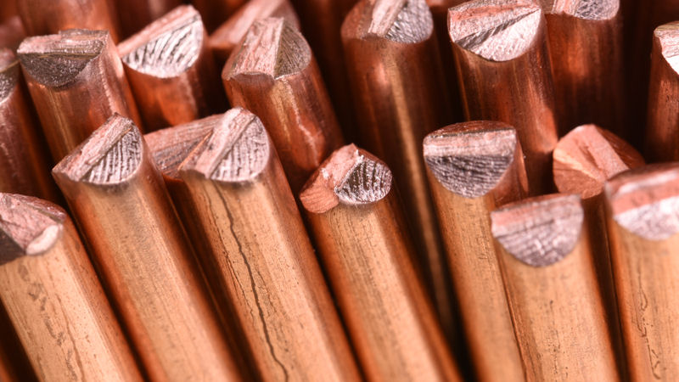
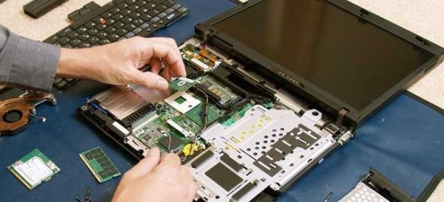
What do we understand by Commodity?
A basic resource or raw material with none or few added value, often used as input to produce other goods or services or to be consumed directly.
e.g. Copper vs Computers
https://www.investorsobserver.com/news/stock-update/freeport-mcmoran-fcx-stock-adds-10-6-over-the-past-week-how-does-it-score
https://www.google.com/url?sa=i&url=https%3A%2F%2Fwww.pinterest.de%2Fpin%2F824932856725267898%2F&psig=AOvVaw1CGGqefpYGKD7_nzAvCBwe&ust=1587538063909000&source=images&cd=vfe&ved=0CAIQjRxqFwoTCLjvor32-OgCFQAAAAAdAAAAABAD

Slide 3
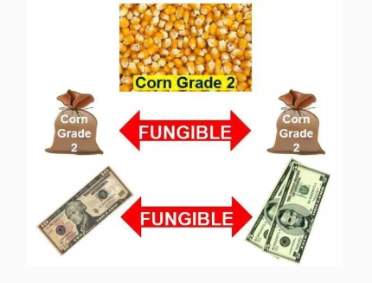
It has fungibility, which means it is interchangeable with other good of the same type. It can be exchange by another identical item. In other words, there is little differentiation from producer to producer.
Non-fungible
https://media.consensys.net/i-made-over-600-in-3-hours-with-non-fungible-tokens-on-the-blockchain-cryptoartwork-4954bc52b354
https://medium.com/@jrgensvenneviknotland/fungible-money-67a57717b2fe

Slide 4
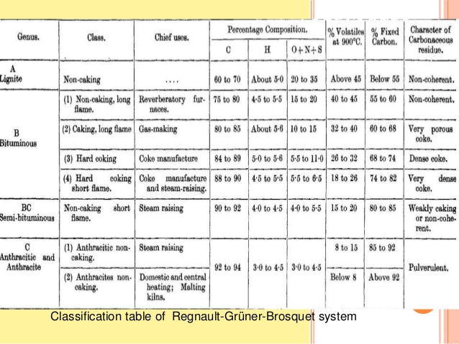
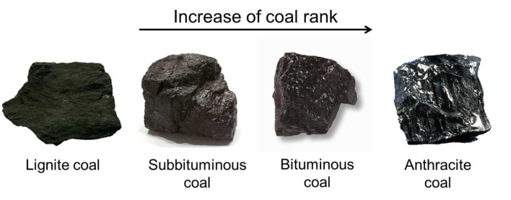
They require standardization, a basis grade to guarantee their exchangeability
https://www.researchgate.net/figure/Classifications-and-rank-of-coal-Credit-Wikimedia-Commons_fig1_278642194

Slide 5
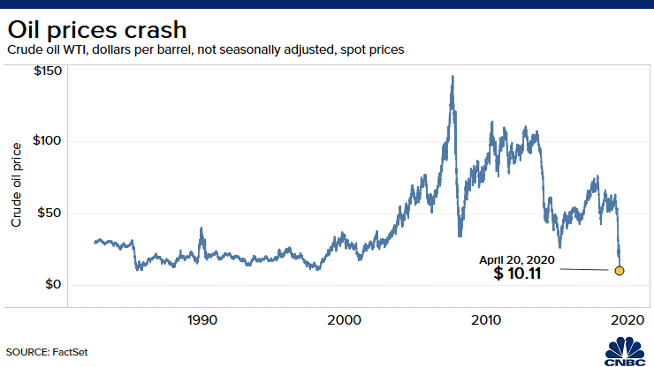
The price is determined by the market (offer and demand) as a whole

Slide 6
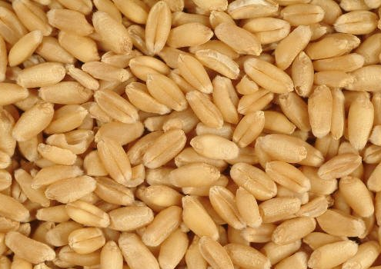
Some commodities are:
NATURAL RESOURCES
Agricultural products (wheat, rice, soy, palm oil, and many more)
Metals (gold, silver, coltan, copper….)
Fossil fuels (coal, oil, gas)
Energy (fossil, nuclear, wind power, etc.)
Commoditization:
When products lost their differentiation across the supply base, or when they are treated in the market as commodities even though they are not produced as one (for example, carbon markets)
The definition now includes also some financial goods such as currencies or bonus.

Slide 7
A commodity can be traded…
On the spot market: also called the physical market or the cash market. It means it is traded for immediate delivery.
On the future market: traded for delivery at a future date but with a price agreed today. In other words the price is secured today, which allows for speculation, investment, hedge for inflation.

Slide 8
Commodity chains
Extraction – production
Transportation
Consumption
Trade and negotiation
https://thebristolcable.org/2016/01/the-real-costs-of-bristol-ports-coal-imports/

Slide 9
Commodity chains
https://thebristolcable.org/2016/01/the-real-costs-of-bristol-ports-coal-imports/

Slide 10
https://marketrealist.com/2016/02/need-know-coal-mining-industry-value-chain/

Slide 11
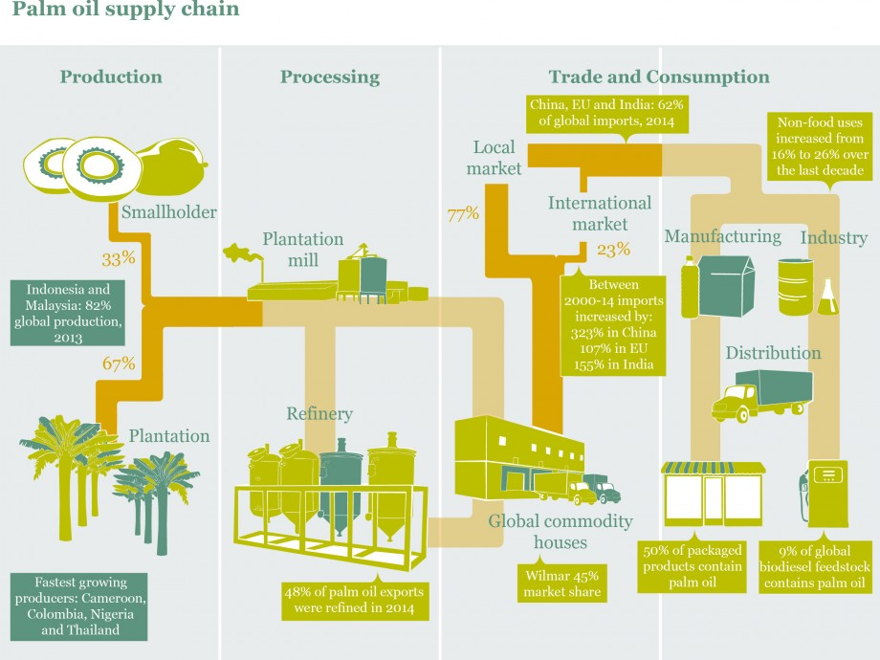
http://sustainablesmartbusiness.com/useful-report-infographics-on-palm-oil-beef-leather-and-soy-supply-chains/

Slide 12
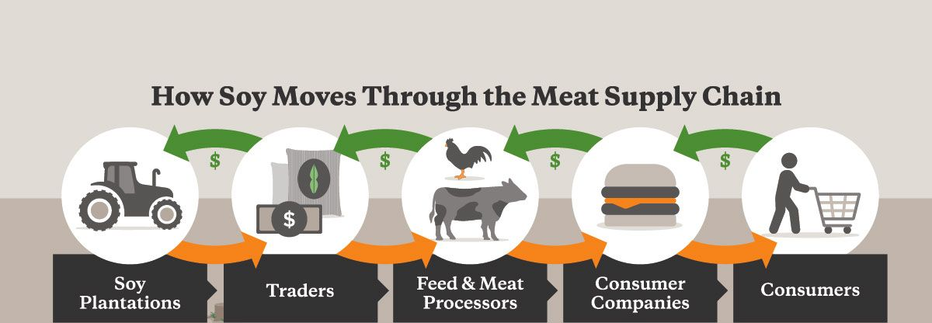
https://stories.mightyearth.org/cargill-worst-company-in-the-world/

Slide 13
Why Infrastructures and why violence in the title of the course?
It is a sort of arbitrary title since there is a lot more to analyze from an anthropological perspective concerning natural resources….
Violence… because of the multiple and unnoticed ways of hard that are implied in natural resource chains and that ultimately make them possible
Infrastructures… to call attention to the systems that make possible the extraction, transportation and consumption of natural resources. Also, to point to the role of non-humans and to the techno natural character of natural resources.
But there is much more that we will observe, such as the experiences, meanings, affects, temporalities, ways of labor, controversies, knowledges and qualifications systems implies in natural resources in their commodified form.

