Slide 1
Aboriginal Culture

Slide 2
Table of Content
Aboriginal People
Dreamtime
What is Dreamtime?
What stories are depicted?
Complexity in Stories
The Seven Sisters
Initiation Process
Social Organisation
Physical or geographic structuring of society
Social structuring of society
Kinship system

Slide 3
Aboriginal People
Indigenous people of Australia
Australia‘s first people
They have lived on the continent for over 50.000 years
Oldest population of humans living outside Africa
Are split into two Groups

Slide 4
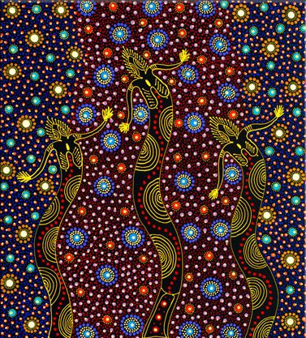
Dreamtime

Slide 5
What is Dreamtime?
Foundation of Aboriginal culture
important features of spiritual beliefs
over 40.000 years old
Oral stories of how world is created by ancestors
Provided the culture with different myths
Seen as a beginning that never ended

Slide 6
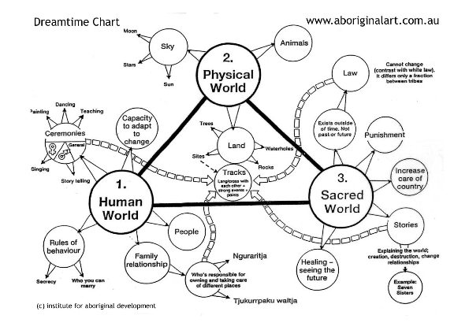
What is Dreamtime?

Slide 7
What Stories are depicted?
There is not one official story
Each land or part of the land has a Dreamtime
Those things that affect society for good or bad
Edible flora
Pearl stones
The moon
Stars
Wind and rain

Slide 8
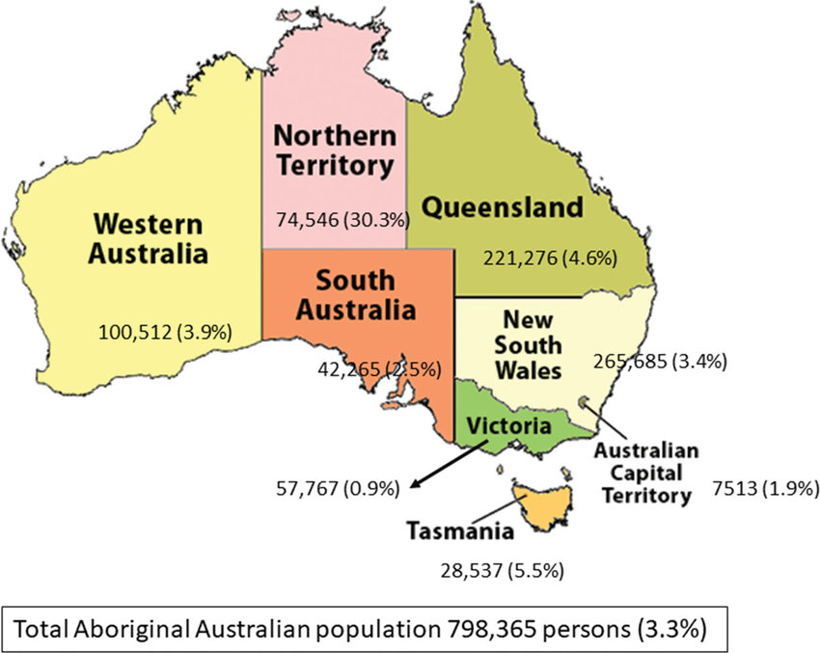
Complexity in Stories
Stories not only differ among territories but also in them
Tribes are subdivided
Multiplicity of perspectives and versions
Fundamental social distinction among sub -groups

Slide 9
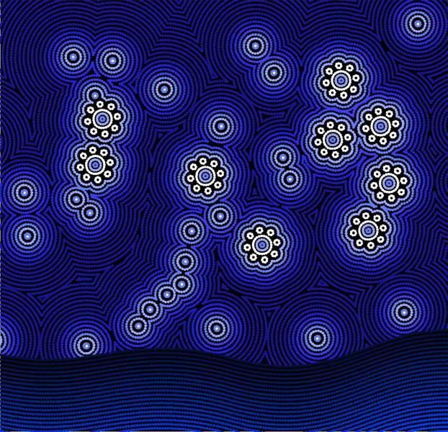
The Seven Sisters

Slide 10
Initiation process
Important event in the life of a young male Aborigine
The initiation process transforms the young man into an adult
Ceremonies consist of circumcision and the incision of scars on chest, shoulders, arms and buttocks
This process permits the young Aborigine to access knowledge from the tribe
The length of the process can vary

Slide 11
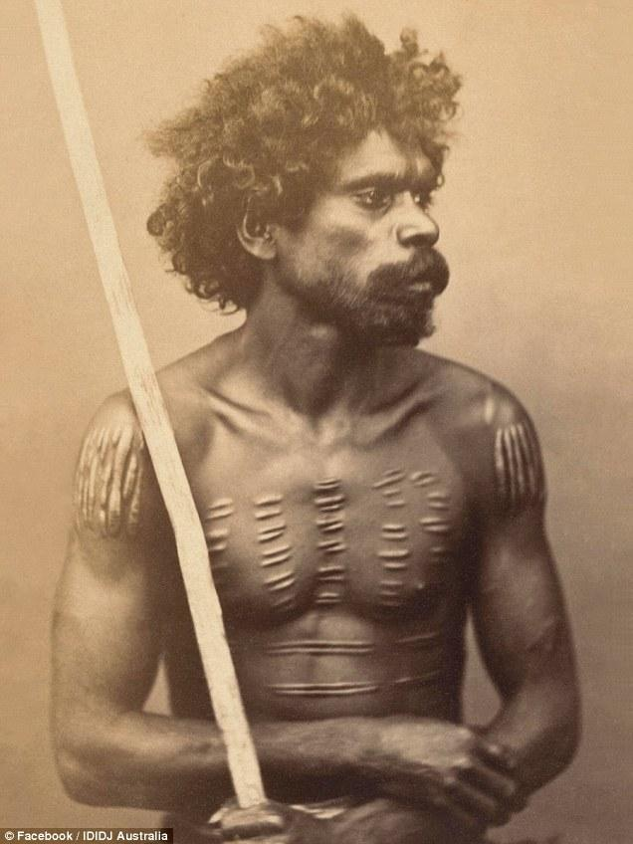
Scarification on the Aboriginal male’s skin

Slide 12
Social Organisation
Can be divided in three parts:
A religious structuring
A physical or geographical structuring
A social structuring

Slide 13
Physical or geographical structuring
Groups of 10-20 people
One language group belongs to a specific tribal land
Tribe consists of about 450 persons

Slide 14
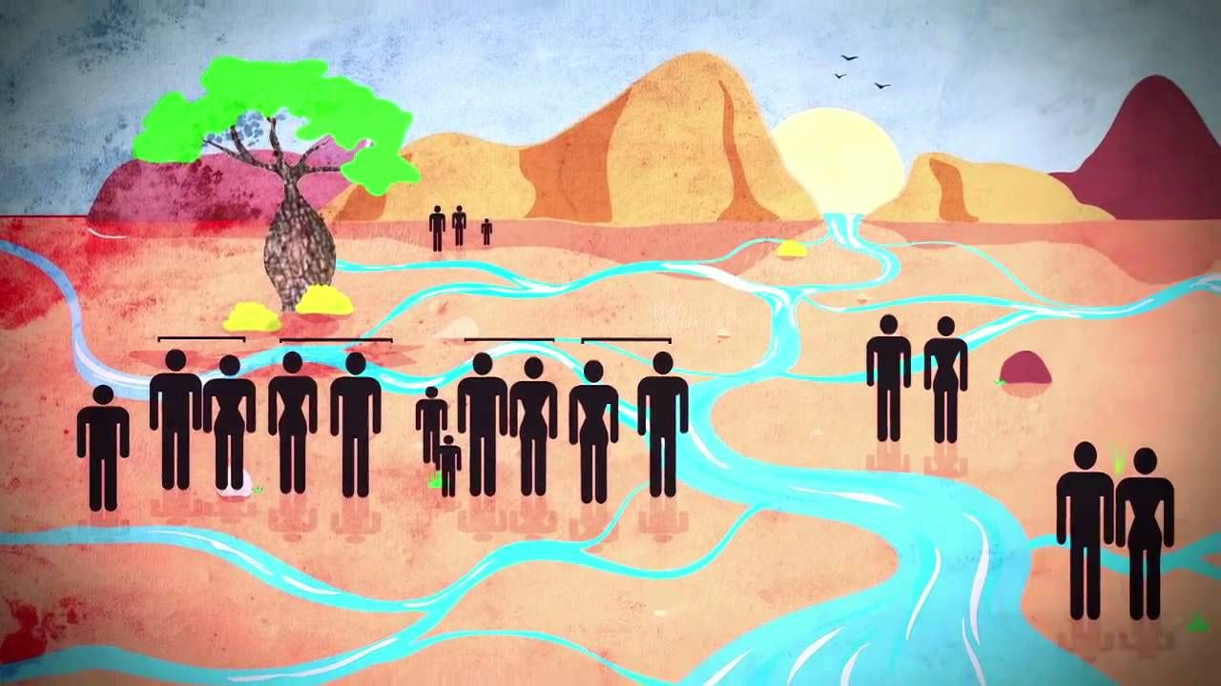
Boundaries
Boundaries defined by rivers, creeks and hills
Poorly defined boundaries lead to the sharing of areas, hostility and even murders

Slide 15
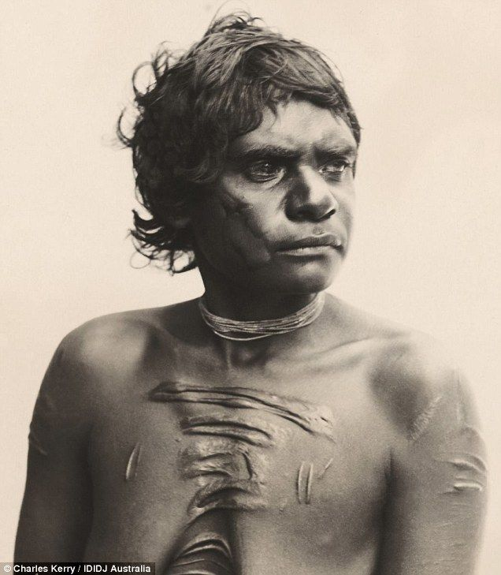
Social Structuring
Connected to the relationships between people
Have to stand a series of ordeals to reach acceptance

Slide 16
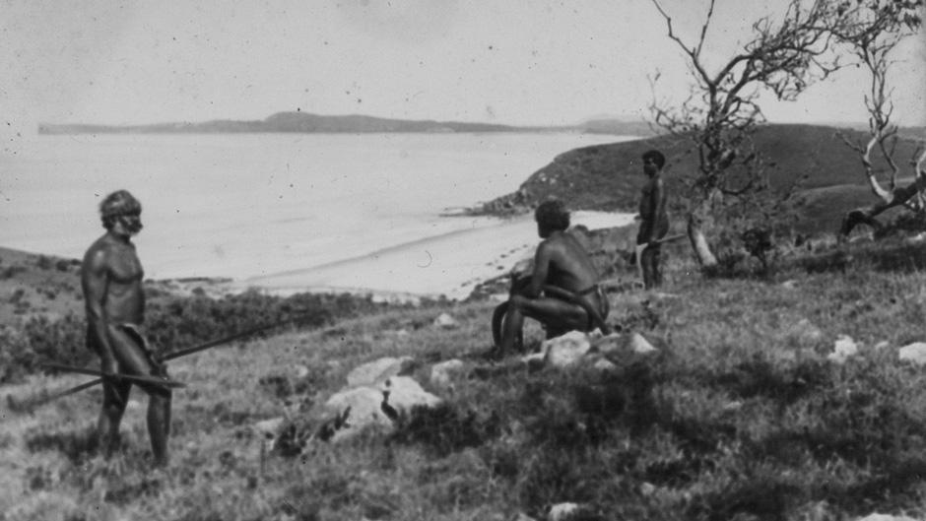
Seniors
Eldest respected men and women are leaders
Council of senior people make important decisions
Senior men were regarded for their specific skills

Slide 17
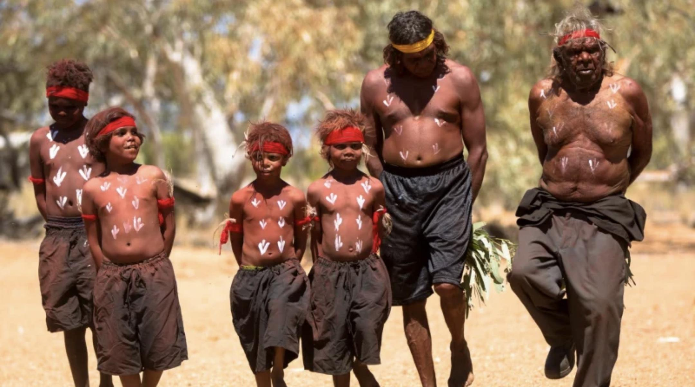
Relatives
70 terms for family relationships
Obligations towards specific relatives
Every family member has equal importance

Slide 18
Kinship system
Structures people‘s relationships, obligations and behaviours
Each person is named in relation to each other

Slide 19
Sources
Aboriginal People
https://www.nationalgeographic.com/culture/article/aboriginal-australians [02/05/22]
Dreamtime
Peter Hiscock (2019): Mysticism and reality in Aboriginal myth: evolution and dynamism in Australian Aboriginal Religion in: Religion, Brain & Behavior.
https://www.aboriginal-art-australia.com/aboriginal-art-library/aboriginal-dreamtime/ [02/05/22]
https://www.aboriginalart.com.au/culture/dreamtime2.html [02/05/22]
https://mbantua.com.au/aboriginal-culture/ [02/05/22]
https://www.artyfactory.com/aboriginal-art/aboriginal-art-dreaming-stories-the-seven-sisters.html [02/05/22]
Initiation Process
https://www.dailymail.co.uk/news/article-5865809/Inside-ancient-art-Aboriginal-body-scarring.html [02/05/22]
Social Organisation
https://www.aboriginalculture.com.au/social-organisation/ [02/05/22]

Slide 20
Sources of Pictures
Dreamtime
https://i.pinimg.com/474x/b1/d4/78/b1d47872a518887b1f7559a6a4bfd0b1--aboriginal-dreamtime-aboriginal-painting.jpg [02/05/22]
https://www.aboriginalart.com.au/culture/dreamtime3.html [02/05/22]
https://www.researchgate.net/figure/Aboriginal-population-by-Australian-state-and-territory-number-of-persons-of_fig1_334732125 [02/05/22]
https://www.artyfactory.com/aboriginal-art/aboriginal-art-dreaming-stories-the-seven-sisters.html [02/05/22]
Social Organisation
https://www.smh.com.au/opinion/aboriginal-australia-pointing-the-way-for-us-all-20151209-glj8f4.html [02/05/22]
https://www.deadlystory.com/page/culture/Life_Lore/Family/Kinship [02/05/22]
https://www.pinterest.de/pin/506092076885272208/ [02/05/22]
https://www.abc.net.au/news/2015-11-24/uncovering-australias-indigenous-past-with-new-photographs/6969778?nw=0&r=HtmlFragment [02/05/22]

