Slide 1
How many cultures can one individual belong to?

Slide 2
Table of contents
Introduction
Globalisation and Cultural appropriation vs cultural appreciation
National Identity and how it is formed and strengthened
Difficulties and advantages of belonging to multiple cultures
Belonging to different cultures in school
Conclusion

Slide 3
Globalisation and Cultural appropriation vs cultural appreciation

Slide 4
Globalisation

Slide 5
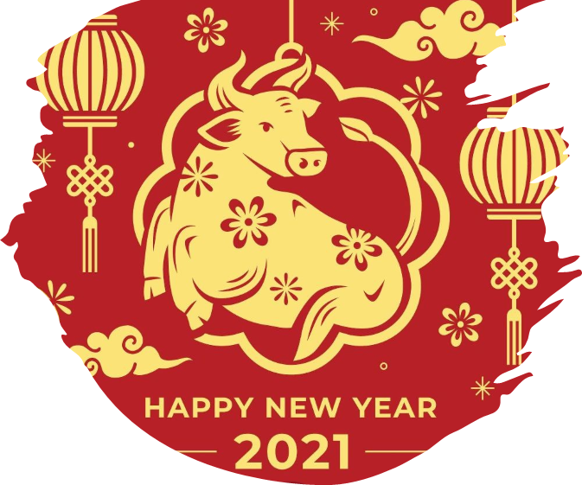
Celebrating different cultures

Slide 6
Wide-spread pop- culture / acceptance

Slide 7
The fine line

Slide 8
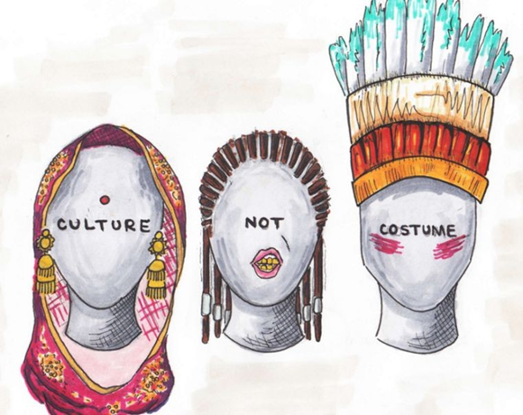
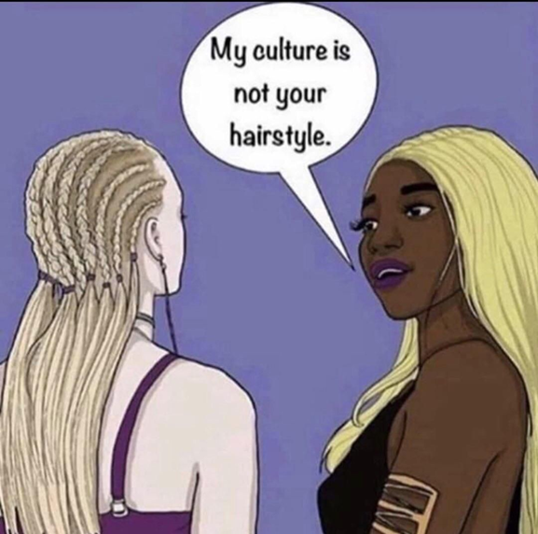

Slide 9
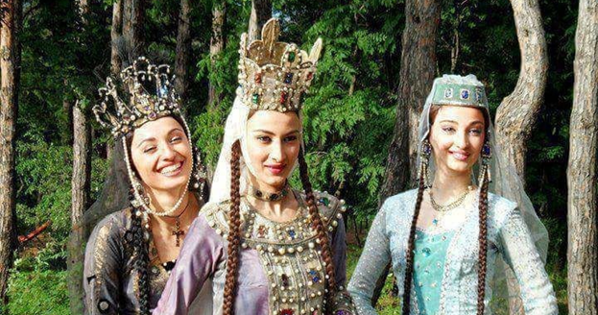
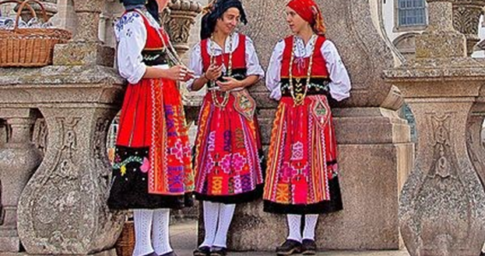
Being a part of different cultures

Slide 10
What is a National Identity?
feeling of belonging
Common national aspects Language, territory, values, beliefs
Heavily influenced by the history
Sense of belonging to a culture / nation
Feeling of Allegiance and solidarity

Slide 11
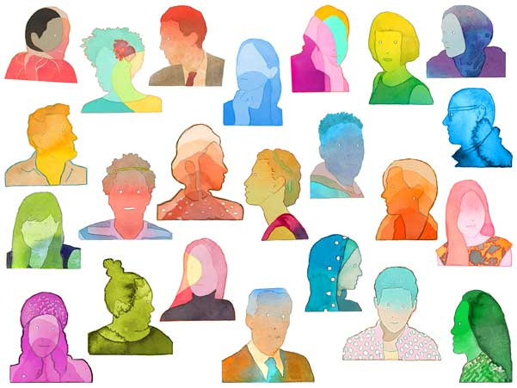
“National identity is conventionally thought of as a social phenomenon that helps me to understand who I am, to understand my place in the chain of being and in the world I inhabit” (Kirloskar-Steinbach 2004: 31).

Slide 12
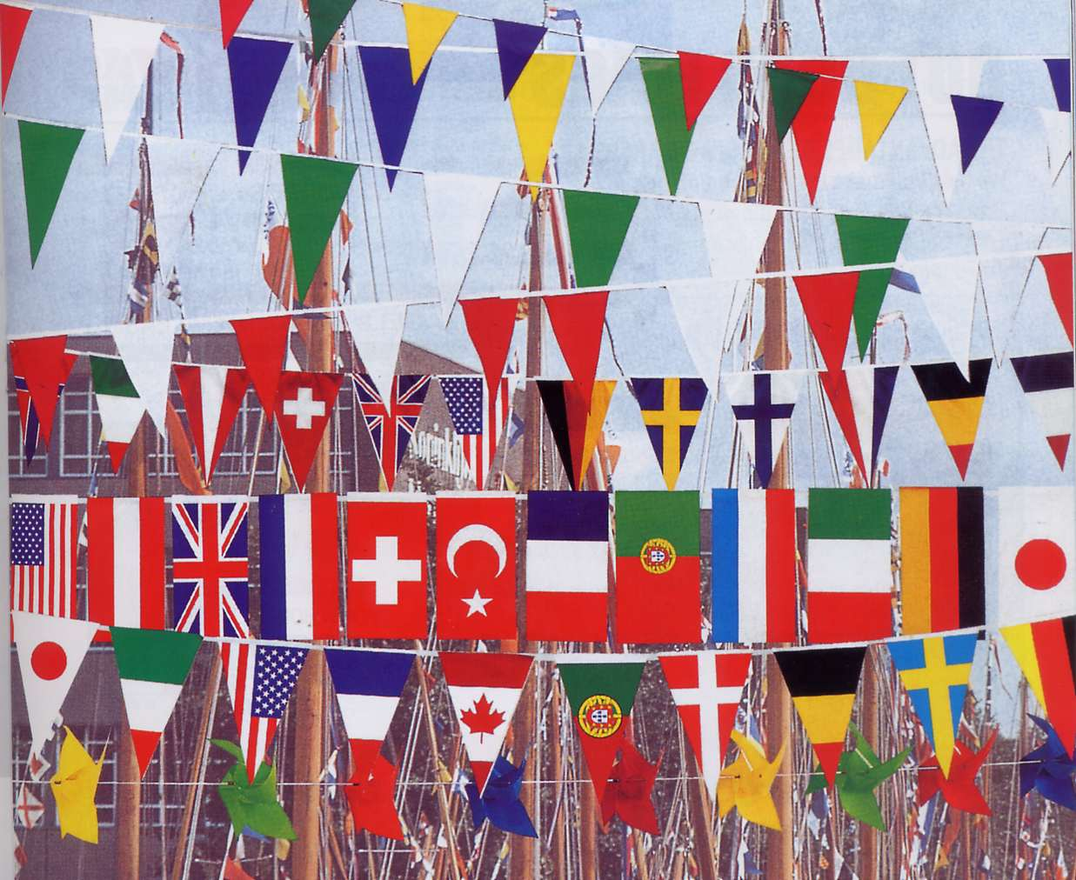
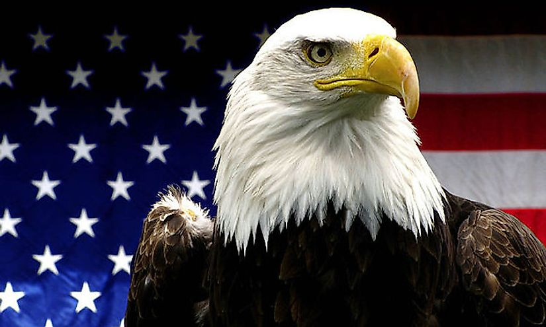
How is a national identity formed?
Usually, one is born into a national identity
It is socially constructed and influenced by society
A national identity can exist regardless of citizenship and passport
National flag
National anthem
National colors, symbols, animals

Slide 13
What strenghtens a national identity?
A common enemy
A common threat
A strong feeling of unity
Feeling close and connected to each other
Example: 9/11

Slide 14
national identity is important to get through difficult times as a nation Giving streangth to each other
When living in a foreign country, a strong national identity can be very helpful in order to feel connected to the home country
But: Too much pride can be dangerous
Important to find a balance between both identities

Slide 15
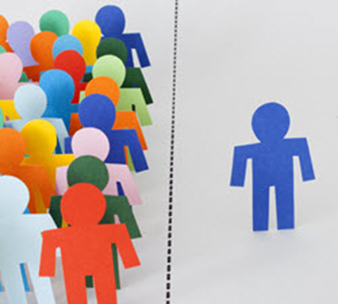
Difficulties
Discrimination
Gap between Cultures is too big → too different
Individual responsibility → Some individuals don‘t try to understand different Cultures
Confusion about belonging

Slide 16
Advantages
More complex thinking
More open minded
Better understanding of different topics → solving problems, helping others
Innovation (business, education system, etc.)

Slide 17
summary
Belonging to more than one culture is possible BUT has its difficulties
Self-development
Awareness about different topics
Innovation

Slide 18
School as a social Institution
many people with various cultures come together
thoughts, beliefs as well as moral values are shared
students learn from each other

Slide 19
School culture
only possible together as a community
written as well as unwritten rules
beliefs, relationships, attitudes, and perceptions
has changed through history

Slide 20
Understanding a different culture

Slide 21
Mediation tasks
require socio-cultural background knowledge
openness towards people with other cultures is taught
Getting to know other cultures

Slide 22
one individual can probably belong to an infinite number of cultures.

Slide 23
List of references
Kirloskar-Steinbach/Monika (2004). National Identity: Belonging to a Cultural Group? Belonging to a Polity http://jsri.ro/ojs/index.php/jsri/article/view/181/181
Hall/Stuart, du Gay/Paul (1997). Questions of Cultural Identity https://books.google.de/books?hl=de&lr=&id=lKiHAwAAQBAJ&oi=fnd&pg=PA87&dq=cultural+belonging+identity&ots=V6hnL3rulU&sig=LTVIyUFN_yXq503LBZzpxElThEc#v=onepage&q=cultural%20belonging%20identity&f=false
https://www.worldatlas.com/r/w1200-h630-c1200x630/upload/8b/e1/9f/640px-american-bald-eagle.jpg
https://www.americanacademy.de/wp-content/uploads/2018/09/GluibizziforStanford-1.jpg
http://flags-by-swi.com/stringflags.jpg
http://3.bp.blogspot.com/-rCktZwNInvQ/UE-araJKV-I/AAAAAAAAAoc/cqTcuMi4EQw/s1600/0420-0906-0909-0951_the_tribute_in_light_memorial_at_ground_zero_in_new_york_o.jpg
https://books.google.de/books?hl=de&lr=&id=fiiklgzDHBAC&oi=fnd&pg=PP1&dq=belonging+more+than+one+culture&ots=o8pHWdqR6Z&sig=FrVNMDXWhNdxqwpCN7oI0rfCCzs#v=onepage&q=belonging%20more%20than%20one%20culture&f=false
https://hbr.org/2019/12/what-makes-you-multicultural
https://www.ukessays.com/essays/cultural-studies/advantages-and-disadvantages-of-different-cultures-cultural-studies-essay.php?__cf_chl_jschl_tk__=668fb6d84049ff33ff44956dcb6ff639d8ac77d1-1611599887-0-AQVS954m0jQ5qmHoPZ24TVan22JgdmZZefdwHJ6DR_yRRSe6M60XrJ2pAbAjiBiR6Gu25WlLd05W9r5DnPenYJQmbDn1XvvFwWg2ttyQ8ER9SyIiEkoFOsPtbf23jjkgxTFYZEHhzrTm3EgOGxQ6oafDy9660PCuguWuUaPamUqLEusYfsdzBUO7QG5N0D0h7w9ihSJr0ZuBE9_901AukVF2zx_uvzS7ZIXLDjfs6NqmSrz--M2rQrRA1dQWAnRXGFf9BTB0SMZwsPE8seH-Vnj8enINHNdumnOkKBpU7qqtShpo3j9ieLnA4jzxFcB8D-tn7IJFyZB7AX98WRJYl3C1pMV1s9tJiTMzjnVWf3LlaibaoyAaQ1LTrQIpYC03Mq9rvyFnoCseJl8a1E6rV0j9j-A5FbQnBowokv2FLJFVGPtIUY6MCahl7QxTFfkttX7SB5ohvB-44xrQelhl5kyTZR7UhdI_rvyXmI8aKXHfHLBza8jsTgNX5Pkrc9pTvg
ttps://www.edglossary.org/school-culture/#:~:text=The%20term%20school%20culture%20generally,of%20students%2C%20the%20orderliness%20of
https://www.dailymail.co.uk/news/article-492872/So-THIS-Britains-Mr-Average.html
https://www.justiceinitiative.org/publications/discrimination-german-schools

