Slide 1
Social Facilitation & Social Loafing Triplett (1898)
Smith & Haslam (2017)
*** Chapter 1 ***

Slide 2
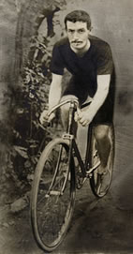
Overview
Overview
1. Background
2. The study
3. Debate and controversy
4. Impact
Reading
Triplett, N (1898). The dynamogenic factors in pacemaking and competition. The American Journal of Psychology, 9(4), 507-533.
Strube, M. J. (2005). What did Triplett really find?/ A contemporary analysis of the first experiment in social psychology. The American Journal of Psychology, 118(2), 271-286.
Bond, C. F., & Titus, L. J. (1983). Social facilitation: A meta-analysis of 241 studies. Psychological Bulletin, 94(2), 265–292.
◻ Karau, S. J., & Williams, K. D. (1993). Social loafing: A meta-analytic review and theoretical integration. Journal of Personality and Social Psychology, 65(4), 681-706.

Slide 3
Learning Goals
Understanding how Triplett’s background has shaped the research question
Appreciation of what makes Triplett’s question about social facilitation a big question
Insight into the demands of Triplett’s methods – for the researcher, the participant and the interpretation of the data
Understanding of Triplett’s findings – and what makes them challenging
Basic knowledge about the work following from Triplett’s study
Appreciation of the impact of the study

Slide 4
Multiple Choice Question
25. | How did Triplett (1898) explain the underperformance of some children in his experiment?
a. | Overstimulation
b. | Motivational loss
c. | Misunderstanding of the task
d. | Age differences
e. | Social loafing

Slide 5
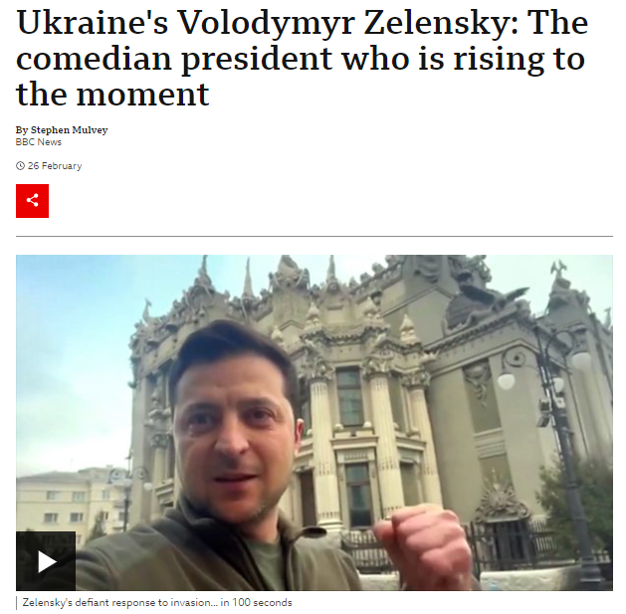
In the news…
BBC News, 26th Feb 2022:
https://www.bbc.co.uk/news/world-europe-59667938

Slide 6
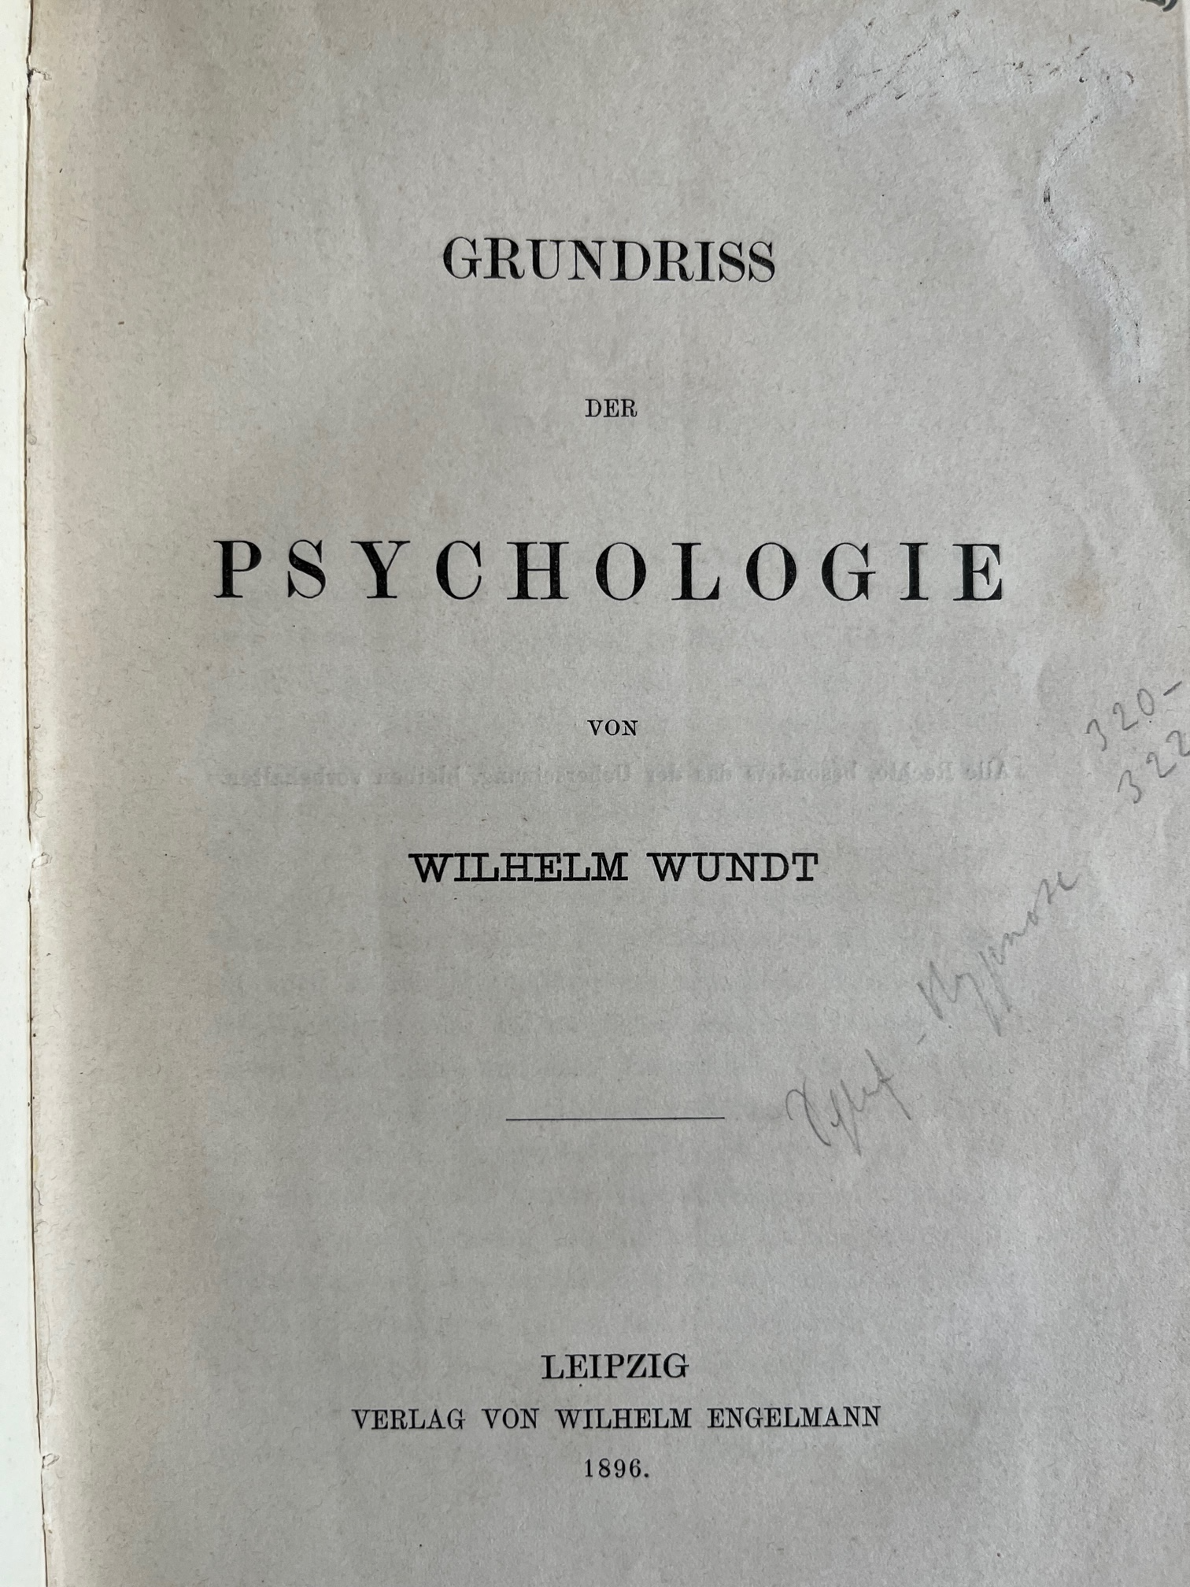
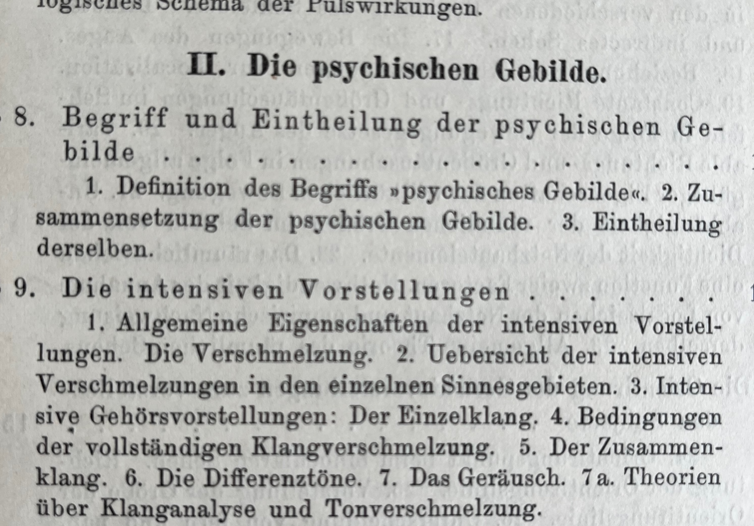
Background

Slide 7
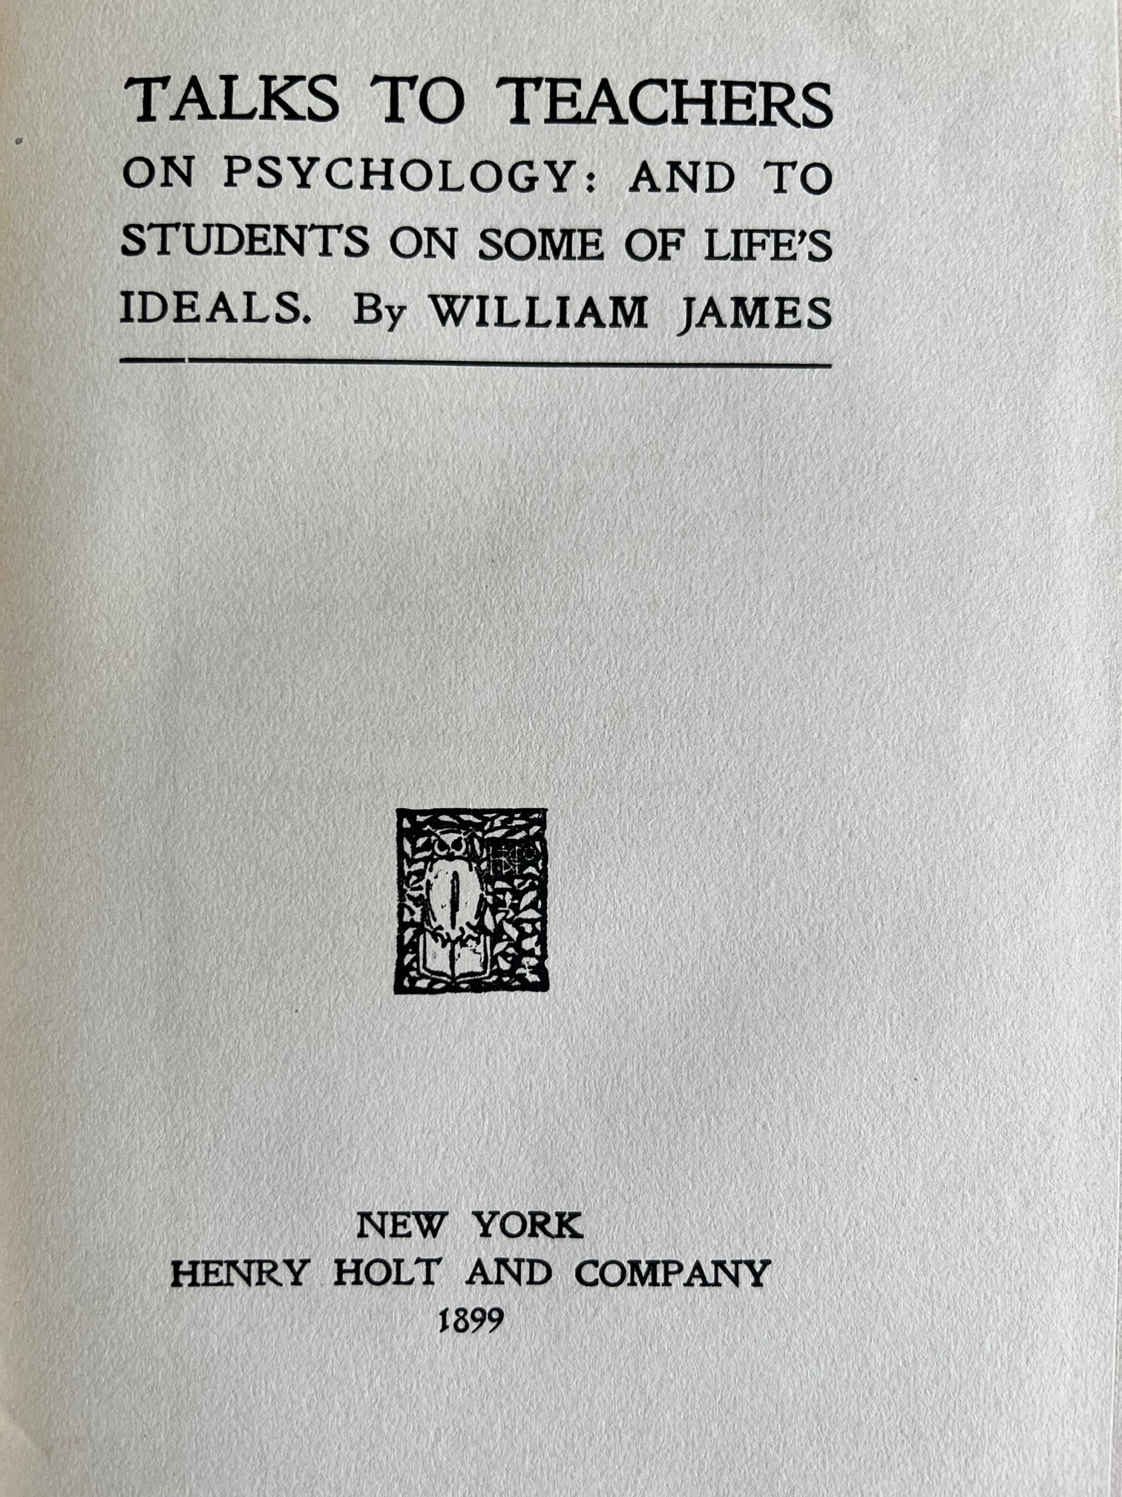
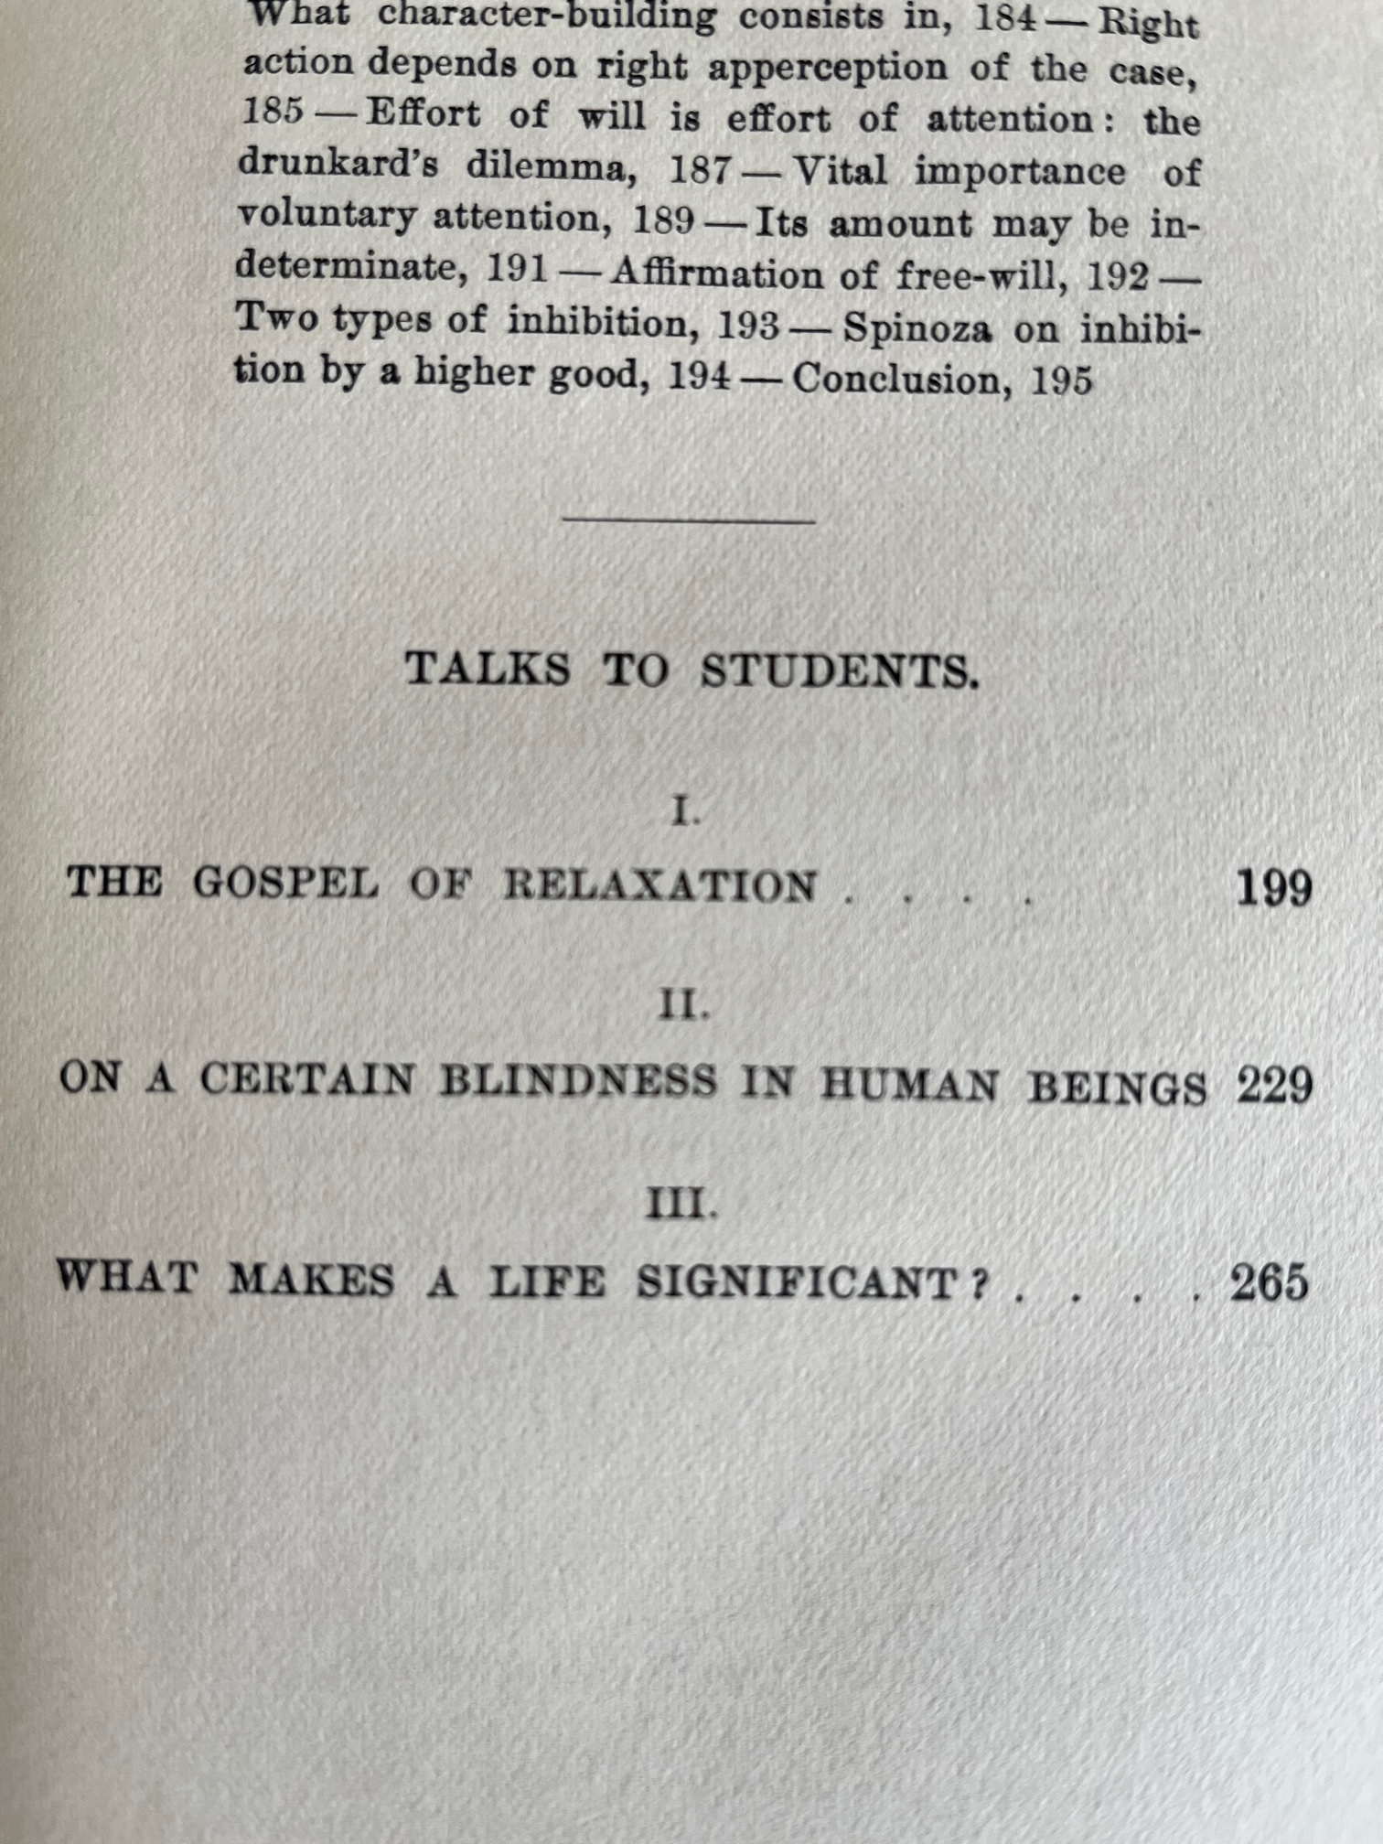
Background
*** Triplett ***
*** Noticing a phenomenon ***

Slide 8
Background
*** Triplett ***
*** Noticing a phenomenon ***

Slide 9
Background
Norman Triplett (1861–1931)
1861: Born on a farm in Perry, Illinois
1889: Graduates from Illinois College, Jacksonville
1889-1895: Works as a school system superintendent and high school science teacher
1895: Starts graduate degree at Indiana University
1898: Masters from Indiana University
Publishes first (ever!?!) study in social psychology
1900: PhD on the psychology of magic
1901: Faculty at Kansas Normal School, Emporia
- Head of the department of child study for 30 years
1931: Dies aged 70

Slide 10
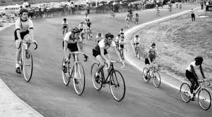
Background
Cycling Competitions
Triplett was a keen sportsman
He noticed that cyclists ride faster when in a group
Analysis of results from cycling events by the Racing Board of the League of American Wheelman for the 1897 season:
Races against other riders
Paced races against time
Unpaced races against time

Slide 11
Background
Cycling Competitions
Results
Races against other riders and paced races are faster than unpaced races (single rider)
Improvement over unpaced races
Races against other riders: 26% (on average 40 secs/mile faster)
Paced races: 23% (on average 34 secs/mile faster)
“[…] wheelmen themselves generally regard the value of a pace to be from 20 to 30 seconds per mile.” (Triplett, 1898, p. 508)

Slide 12
Background
Cycling Competitions
Theory | Explanation or relevant quote
Suction | “the vacuum left behind the pacing machine draws the rider following along with it” (p. 514)
Shelter | Following a rider provides shelter from wind resistance
Encouragement | “The presence of a friend on the pacing machine to encourage and keep up the spirits of the rider…” (p. 514)
Worry | Leading a race or keeping the pace requires a greater deal of concentration or worry than following the pace
Hypnotic suggestion | Strained attention to the wheel of the pacing bike produces hypnotism
Automatic | Followers can ride automatically as they need to pay less attention to strategy
Dynamogenic | “This theory of competition holds that the bodily presence of another rider is a stimulus to the racer in arousing the competitive instinct; that another can thus be the means of releasing or freeing nervous energy…” (p. 516)

Slide 13
The Study
*** The Lab Experiment ***

Slide 14
The Study
Triplett’s criticism of the cycling data
Triplett highlighted limitations of his cycling analysis:
He also works in one of the first established experimental labs
“Regarding the faster time of the paced races, as derived from the records, it may be asked whether the difference is due to pacing or to the kind of men who take part. […] Men fast at one kind of racing are found to be comparatively slow at another. […] The racer finds by experience that race in which [he or she] is best fitted to excel and specialize in that (Triplett, 1898, p. 508)

Slide 15
Demonstration
4 Volunteers

Slide 16
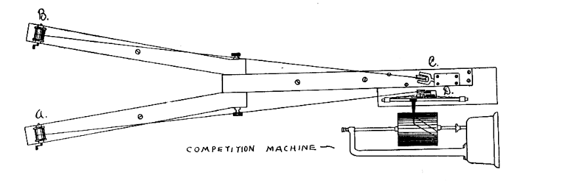
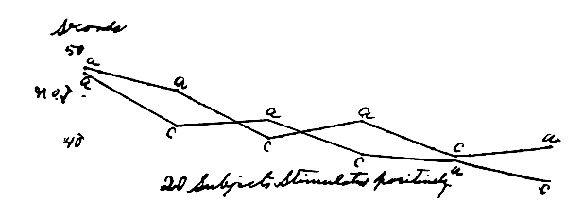
The Study
The ‘Social Facilitation’ Experiment
Method
‘Competition Machine’: Two fishing reels that each pull a flag across a 4m circuit when reeled rapidly
Stopwatch and Kymograph: Record the time and a graphical record of the rate at which participants turned the fishing reel

Slide 17
The Study
The ‘Social Facilitation’ Experiment
Method
N = 40 children, age: 8-17 years
Practice rounds: until all children are familiar with the machine
Trials: 6 trials of 4 rounds, lasting 30-40 sec each, 5 mins rest in-between
Group A: alone, competition, alone, competition, alone, competition
Group B: alone, alone, competition, alone, competition, alone

Slide 18
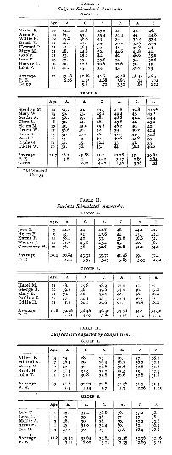
The Study
The ‘Social Facilitation’ Experiment
Results
No statistical analysis at the time; presentation of raw data & drawings
3 tables presented:
(1.) Positively stimulated (N = 20): Faster times in competition
(2.) Overstimulated: (N = 10) Slower times in competition
(3.) Little affected (N = 10): Same times competition and alone

Slide 19
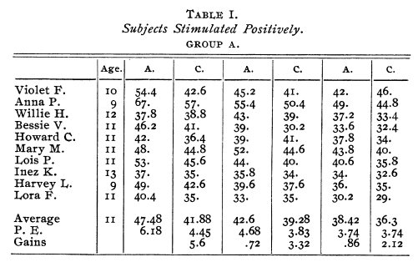
The Study
The ‘Social Facilitation’ Experiment
Results

Slide 20
The Study
The ‘Social Facilitation’ Experiment
Interpretation
Overstimulated children
Not lack of motivation!
“With them stimulation brought a loss of control. In one or more of the competition trials of each subject in this group the time is very much slower than that made in the preceding trial alone. […] This seems to be brought about in large measure by the mental attitude of the subject. An intense desire to win, for instance, often resulting in over-stimulation. Accompanying phenomena were laboured breathing, flushed faces and a stiffening or contraction of the muscles in the arm.” (Triplett, 1898, p. 523)

Slide 21
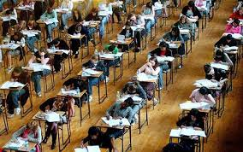
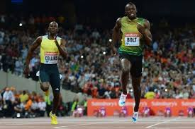
Reflection Activity
For which activities does the presence of others
Improve your performance?
Inhibit your performance?

Slide 22
Debate & Controversy
*** Statistical Analysis, Social loafing ***

Slide 23
Debate & Controversy
Statistical analysis of Triplett’s data
(Strube, 2005)
Triplett did not have statistical techniques available
Strube’s (2005) analysis of Triplett’s data shows:
Significant competition effect in trial 3 between Group A (competition) and Group B (alone) – no other significant differences!
Within-subjects analysis: Contrast between average competition times (M = 37.45 sec) and average alone times (M = 38.14 sec) shows significant but small difference (p = .048)
Small reduction of 1.81% in trial times

Slide 24
Debate & Controversy
Over-stimulation
Triplett made detailed suggestions on the processes behind the effects he observed
Other researchers looked more closely at when groups reduce performance:
Ringelmann: Social loafing
Zajonc: Social facilitation and social loafing in animals and humans
Latané: Social inhibition/social loafing

Slide 25
Debate & Controversy
Ringelmann Effect
Max Ringelmann conducted studies in the 1880s that examined how group size affects individual effort
Published in 1913 in a French agricultural journal
Task: Men in groups of different sizes pull on a rope
Dependent variable: Force
Result: Increase in total force exerted is less than would be expected from the addition of individual scores
Motivational loss?

Slide 26
Debate & Controversy
Zajonc’s Integration
Inconsistencies in findings regarding social facilitation stifle research in the 1940s and 1950s
Robert Zajonc (1965) uses drive theory to explain inconsistencies:
Presence of other people as a source of arousal
Arousal tends to facilitate the dominant response
Simple/well-learned tasks: Dominant responses tend to be correct
Presence of others should lead to social facilitation
Complex/novel tasks: Dominant responses usually incorrect or inefficient
Presence of others should lead to social inhibition

Slide 27
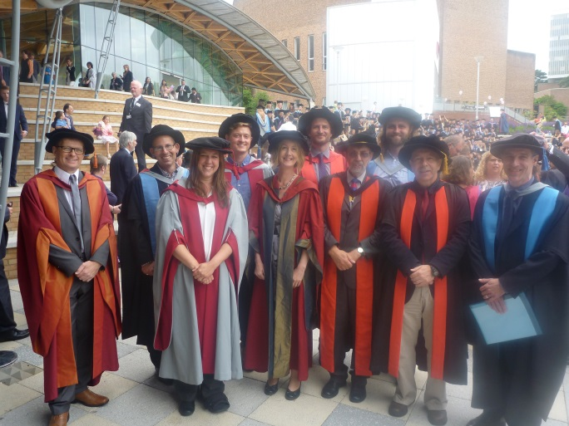
Debate & Controversy
Social facilitation VS. Social loafing?
Differences in ‘Others’ present:
Social facilitation research
Observers, co-actors, audience members
Lead to arousal, evaluation, distraction
Social loafing research
Co-workers or teammates
Opportunity to reduce efforts

Slide 28
Class Activity
What can social facilitation/social loafing tell us about…
…Asch’s conformity experiment?
…Latané & Darley’s bystander effect?

Slide 29
The Impact
*** Hallmarks of Good Research ***

Slide 30
Impact
Features of High-Quality Research
By publishing the first (?) social psychological experiment, Triplett set the standard, providing some of the hallmarks of good research:
Multiple methodologies
Multiple theories, competing hypotheses
Precision and attention to detail
Modelling of real-world dynamics in a controlled environment
Control of confounding variables

Slide 31
Impact
Social Facilitation & Social Loafing
Triplett’s work sparked hundreds of studies on the way the presence of other people affects individual motivation and effort
Different ‘Others’: Observers, co-actors/co-workers, audiences
Different Tasks: simple/well-learned, complex/novel
Animals and humans
Underlying Processes
Development of theories

Slide 32
Triplett Revisited 2022
The influence of competitive anxiety on social facilitation in a sport psychological context
Masterthesis Summer Term 2022
Helena Weiler

Slide 33
Hypotheses
(H1) Participants are faster on an Ergometer when competing against another cyclist compared to an individual condition.
(H2) Participants with lower competition-related state anxiety are faster than participants with higher competition-related state anxiety.
(H3) Participants with higher competition-related state anxiety are slower when competing against another cyclist.

Slide 34
Sample
39 high school students (OberstufenschülerInnen)
Age between 16 and 19 years
15 female, 24 male
14 top athletes (LeistungssportlerInnen)
Design
Experimental Repeated Measures Design (within-design)
IV: experimental condition (individual, competition), competition-related state anxiety
DV: Performace (time on a fixed distance)

Slide 35
Material
Demographics
....
Wettkampfangst-Inventar-Trait (WAI-T) (Brand, Ehrenspiel, & Graf, 2009)
Wattbike Trainer (Ergometer)
Performance Monitor
Wattbike Power Cycling SE 3.0 (Wattbike Software)

Slide 36
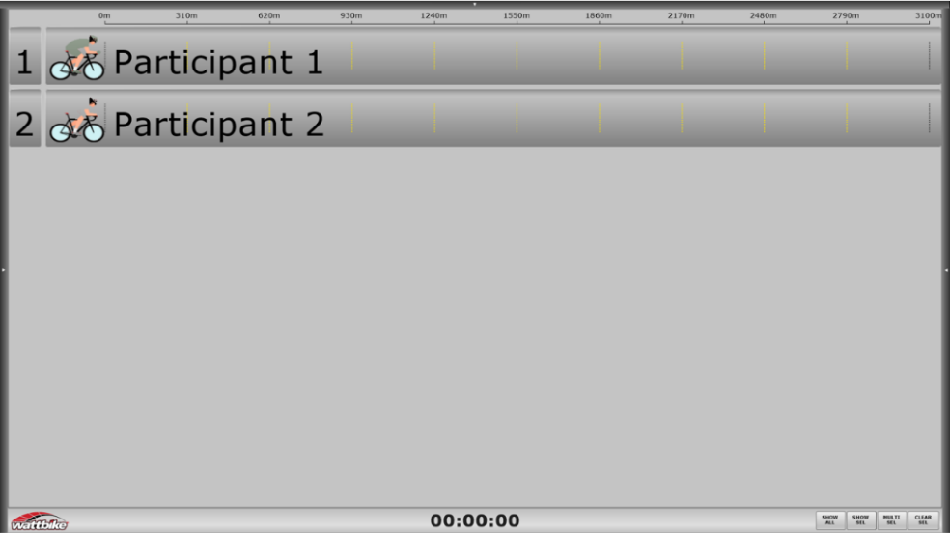
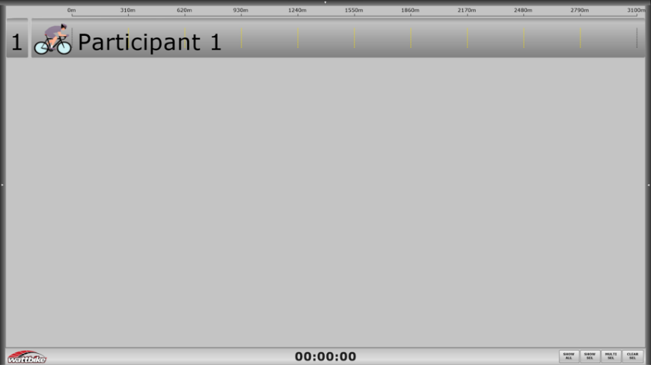
Wattbike Power Cycling SE 3.0 (Wattbike Software)
Fig. 1 Race Activity, competition
Fig. 1 Race Activity, individual

Slide 37
Results
(H1)
t-tests paired sample
Individual (M = 294,13, SD = 26,620) vs. Competition (M = 293,54, SD = 30,226)
t (38) = .299; p = .766, d = .048

Slide 38
Results
(H2) Participants with lower competition-related state anxiety are faster than participants with higher competition-related state anxiety.
Pearson-Correlations
Individual: No relation between anxiety and performance, r = .095, p = .567
Competition: No relation between anxiety and performance, r = .049, p = .767

Slide 39
Results
(H3) Participants with higher competition-related state anxiety are slower when competing against another cyclist.
Hierarchical regression
No main effects, no interaction effect, B = (-).452, SE B = 2.553, β = (-).066, p = .860

Slide 40
Revision
*** MCQ ***

Slide 41
Multiple Choice Question
25. | How did Triplett (1898) explain the underperformance of some children in his experiment?
a. | Overstimulation
b. | Motivational loss
c. | Misunderstanding of the task
d. | Age differences
e. | Social loafing

Slide 42
Q&A

